Slide 1
Flight Price
Prediction
Project
Submitted by: Neha

Slide 2

Introduction
Anyone who has s booked a flight ticket knows how unexpectedly the prices vary. The cheapest available ticket on a given flight gets more and less expensive over time. This usually happens as an attempt to maximize revenue based on, Time of purchase patterns (making sure last-minute purchases are expensive) Keeping the flight as full as they want it (raising prices on a flight that is filling up to reduce sales and hold back inventory for those expensive last-minute expensive purchases). So we are working on a project where we collect flight fare data and make a model to predict fares of flights.

Slide 3
IMPORTING THE DATASET
Firstly we have imported the dataset(flight_ticket.csv) which we have created by scraping the data from different flight ticket booking websites and then stored the data in pandas dataframe.
Created an instance named df for the dataset.
We have 2000 rows and 7columns in our dataset.

Slide 4
IDENTIFYING THE TYPE OF PROBLEM
We have seen that the "Price" column is our dependent target variable in the dataset.
We have seen that the dependent column "Price" is continuous in nature.
Thus it is a linear Regression Problem.

Slide 5
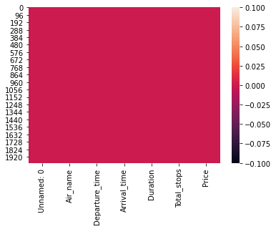
Exploratory Data Analysis
Firstly we have done the basic analysis of the data like- shape, type isnull, etc.
By checking the null values we can see that no null data is present in any column.
We have used a heatmap to see the null values present in the dataset.
D

Slide 6
STATISTICAL SUMMARY
We got a lot of information from the statistical summary of the data.
After observing the statistical table, we have seen that few outliers are present in the "Duration" column.
The difference in mean and median is almost similar.
There is a small difference between the range of each column

Slide 7
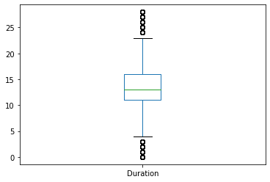
Univariate Analysis
Using Boxplot
We have used a boxplot for each of the columns. Here we have a boxplot of the Duration column.
Here in the duration column we can see that we have many outliers as some of the duration are very long and some of are very short
D

Slide 8
Bivariate Analysis
Using Strip plot
We have used a strip plot for r bivariate analysis to see the relation of each column with the target column. Here is a strip plot of the column Air_name.
We can clearly see the ticket price of each type of flight.
D

Slide 9
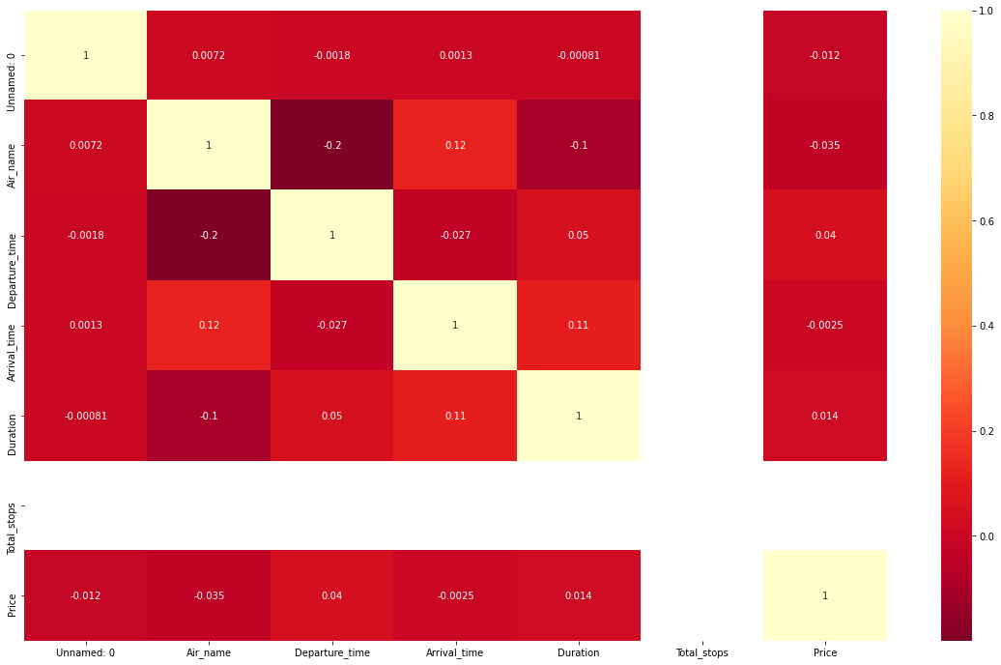
Multivariate Analysis
D
In the correlation matrix, we can see the relation of each column with all the other columns. We can see the correlation matrix in the plot. We have also used a pair plot to see the graphical relation of each column with the other columns.

Slide 10
Now we can clearly indentify the correlation of independent variable with the target variable"Price".
Light shades are highly positively correlated.
Air_name is highly negatively correlated with price.
Other column are slightly positiveely correlated with price column.

Slide 11
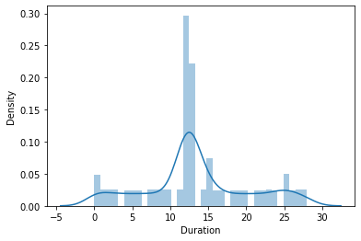
Checking Skewness
Here we have checked the skewness of each column of the dataset.
Here we have a skewness plot of the column Duration, here we can see the skewness in all the curves, curves are not normally distributed we will remove the skewness later on using the appropriate method.
D

Slide 12
DATA CLEANING
Handling the missing values
As we have already seen that we have no missing values in any column.So no need to treat it

Slide 13
DROPPING THE COLUMNS
Now we are dropping the highly negatively correlated columns from our dataset, which are Air_name and Total_stops, and the owner column.

Slide 14
LABEL ENCODING
We have many columns having data type object so we have changed them to integer format using the Label Encoding technique.

Slide 15
REMOVING THE OUTLIERS
From the univariate and bivariate analysis, we have seen that only a few outliers are present in only duration column. So we are not removing the outliers from the dataset.

Slide 16
REMOVING SKEWNESS
We have seen that skewness is present in only a few columns which are very minor so need to remove skewness.

Slide 17
Creating the Train Test Split: Here we have split our data for training and testing in a 7:3 ratio.
Random State: We have chosen 52 as the random state for our models.

Slide 18
FINDING THE BEST ALGORITHM USING MULTIPLE MODELS
We have used different regression models listed below:
LinearRegression()
DecisionTreeRegressor()
SVR()
KNeighborsRegressor()
Lasso(alpha=0.0001)
Ridge(alpha=0.0001)

Slide 19
EVALUATION METRICS
It's a regression problem thus we have used r2_score, mean absolute error mean squared error, and root means squared error as the evaluation metrics.

Slide 20
After using all the models we are getting different errors and different r2_score values for all the models.
We are getting the highest accuracy with the Decision Tree Regressor.
But the accuracy we are getting can be due to overfitting so we check for cross-validation scores.

Slide 21
CHECKING FOR CROSS-VALIDATION
By checking the cross-validation we have observed that the minimum difference between cross-validation and accuracy is for the Decision Tree Regressor.

Slide 22
HYPER PARAMETER TUNING
Now we will perform hyperparameter tuning to get the best parameter for our models:
Decision Tree Regressor: For the decision tree regressor we have observed that the accuracy is 37%.
KNeighbors Regressor: For Kneighbors regressor we have 36% accuracy.

Slide 23
Saving the Best Model
As we have seen that after hyperparameter tuning we are getting the highest accuracy with the Decision tree regressor model, So DecisionTreeRegressor is our best model.
Later on, we will use this model to make future predictions.

Slide 24
Thanks.

